Slide 1

Group9.getEvent()
AN EVENT REPOSITORY
Namrata Singh
Naveenraj Palanisamy
Navya Vandanapu
Niveditha Varadha Chandrasekaran
Shravya Kuncha

Slide 2
Changes from Iteration 1
VISION
To create a web application – EventIt!,
A one stop event repository that helps people to know about the various events happening in and around their neighborhood.
Which serves as a platform for the event hosts to promote their ticket free events.
Domain Model
Use Case Diagram
Use Case Text
Operation Contract

Slide 3
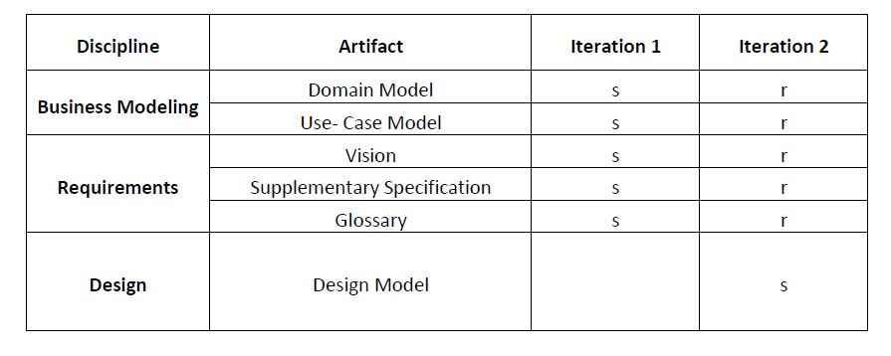
DEVELOPMENT CASE

Slide 4
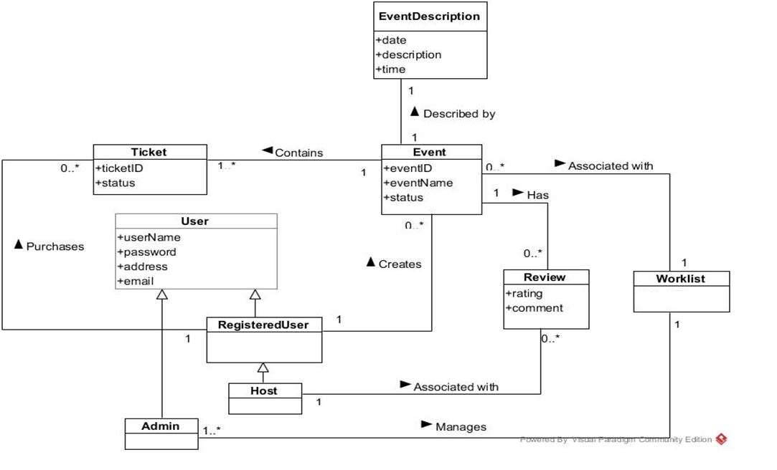
Domain Model

Slide 5
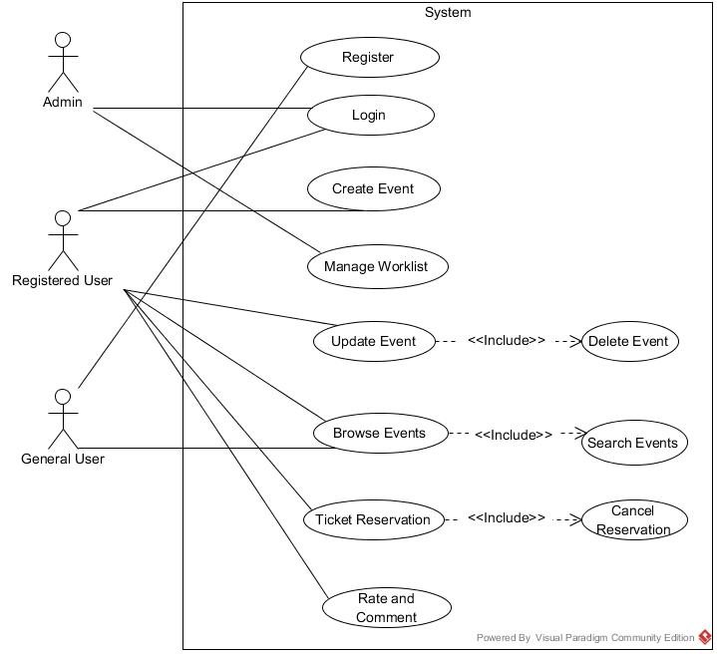
USE CASE DIAGRAM

Slide 6
USE CASES- ITERATION 2
TICKET RESERVATION
CANCEL TICKET RESERVATION
SEARCH EVENTS

Slide 7
USE CASE TEXT

Slide 8
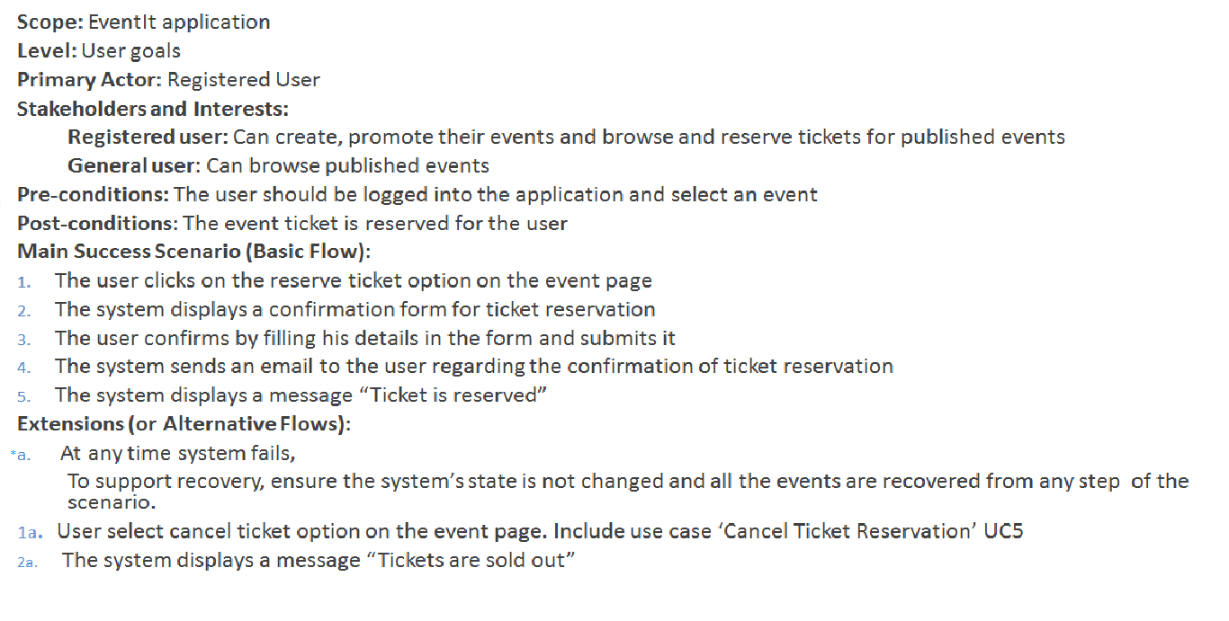
USE CASE UC4: TICKET RESERVATION

Slide 9
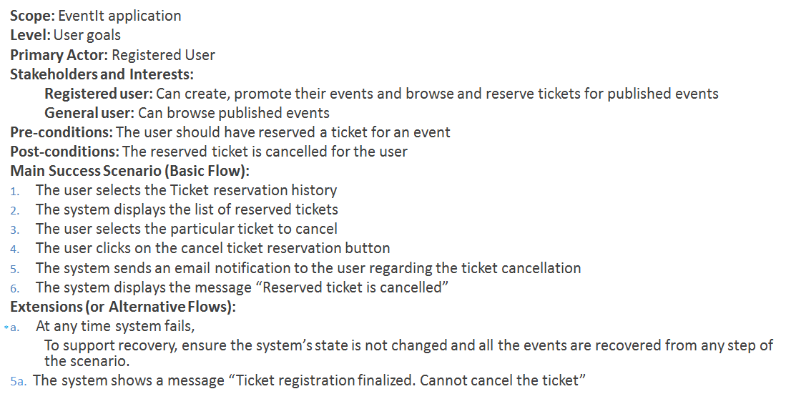
USE CASE UC5: CANCEL TICKET RESERVATION

Slide 10
USE CASE UC6: SEARCH EVENTS
Scope: EventIt application
Level: User goals
Primary Actor: General User, Registered User
Stakeholders and Interests:
Registered user: Can create, promote their events and browse and reserve tickets for published events
General user: Can browse published events
Pre-conditions: The user should select browse events tab
Post-conditions: The events are sorted and displayed based on the selected filter
Main Success Scenario (Basic Flow):
The user selects the filter (by category or by date) by which events should be sorted and displayed
The system displays the list of events based on the selected filter
Extensions (or Alternative Flows):
*a. At any time system fails,
To support recovery, ensure the system’s state is not changed and all the events are recovered from any step of the scenario.

Slide 11
System Sequence Diagrams

Slide 12
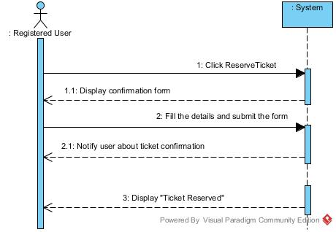
TICKET RESERVATION

Slide 13
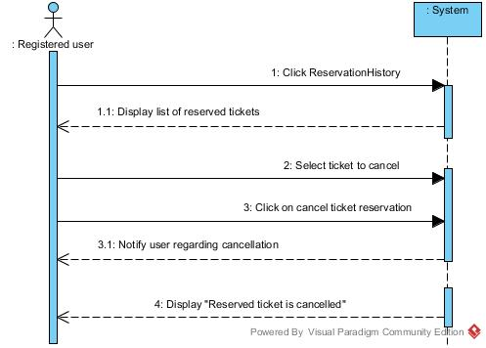
CANCEL TICKET RESERVATION

Slide 14
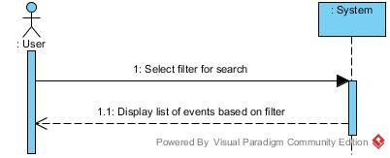
SEARCH EVENTS

Slide 15
OPERATION CONTRACTS

Slide 16
Operation Contracts
Contract 1: Create Event
Operation: createEvent (EventName: varchar, Decr: varchar, Venue: varchar, Date: date)
Cross Reference: Use case: Create Event
Preconditions: none
Post conditions: Event instance E was created
Attributes of E were initialized
Work List instance W was created
E and W were associated
Contract 2: Manage Work List
Operation: updateWorkList(Event: varchar)
Cross Reference: Use case: Create Event
Preconditions: There is a Create event underway
Post conditions: Attributes of W were modified
Work instance W was updated
Contract 3: BrowseEvents
Operation: getallevents()
Cross Reference: Use case: Browse Events
Preconditions: none
Post conditions: E.display() became true

Slide 17
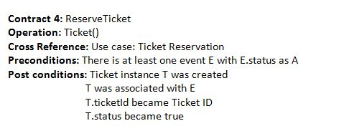
Contract 4: ReserveTicket

Slide 18
Contract 5: Cancel Ticket
Contract 5: Cancel Ticket
Operation: getticket()
Cross Reference: Use case: Ticket Reservation
Preconditions: There should be a Ticket T for an event with T.status as true
Post conditions: T.status became false

Slide 19
Contract 6: SearchEvents
Contract 6: SearchEvents
Operation: getallevents()
Cross Reference: Use case: Search Events
Preconditions: There is a Browse event underway
Post conditions: Check instance C was created
Events E were associated with C
E.display() became true

Slide 20
INTERACTION DIAGRAMS

Slide 21
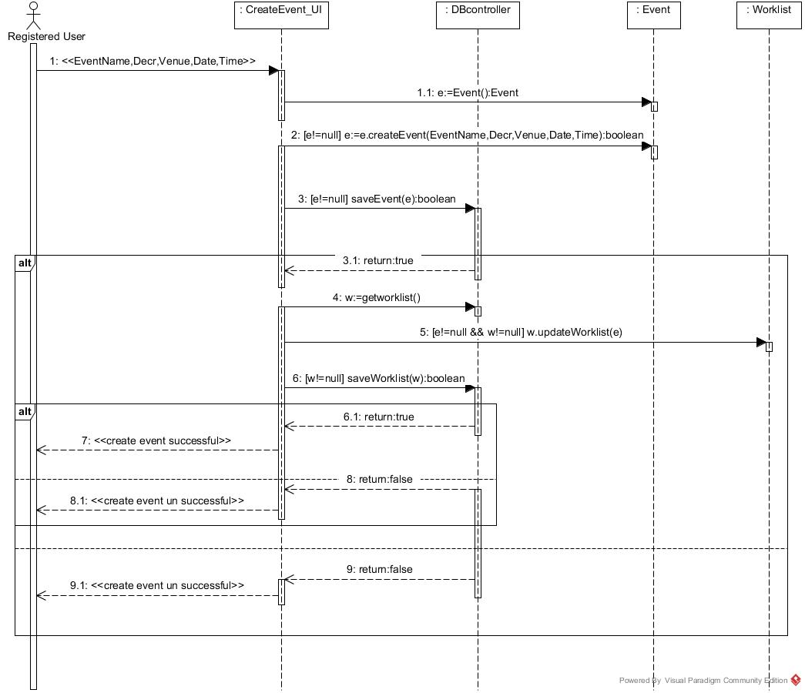
CREATE EVENT

Slide 22
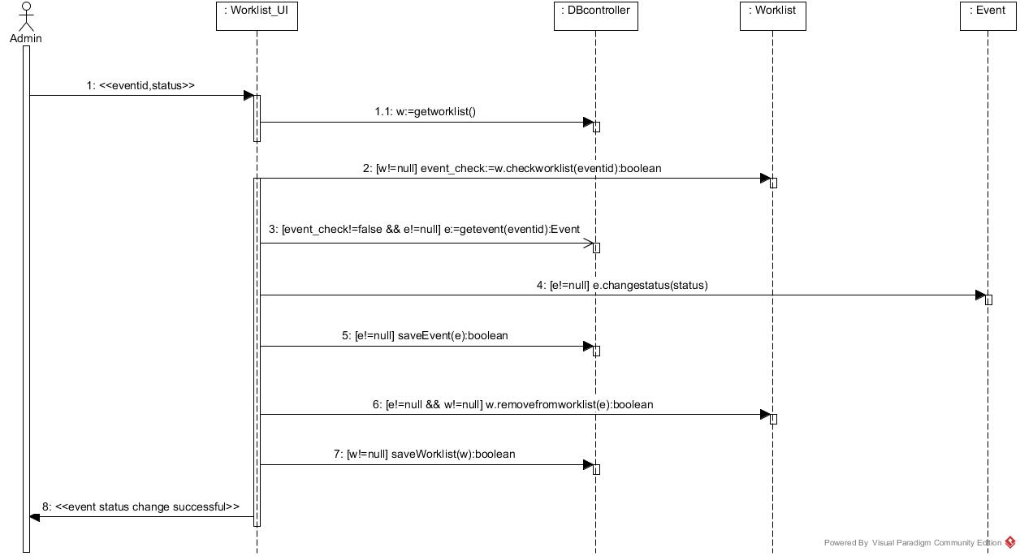
MANAGE WORKLIST

Slide 23
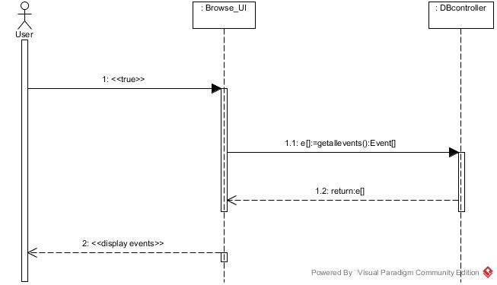
BROWSE EVENTS

Slide 24
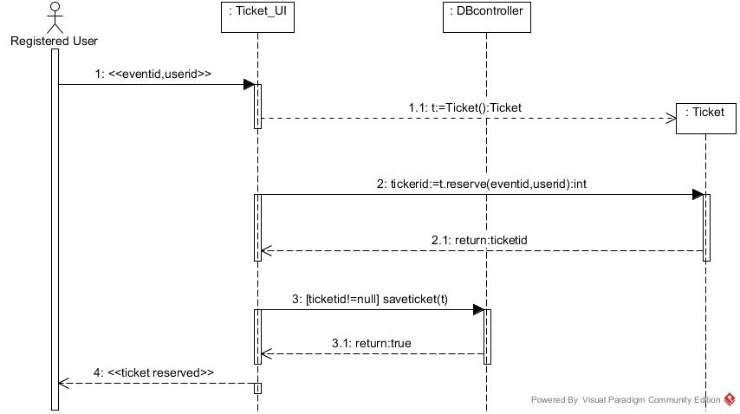
TICKET RESERVATION

Slide 25
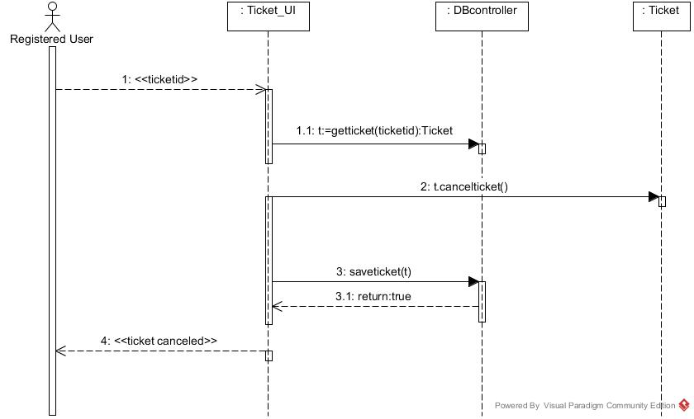
CANCEL TICKET RESERVATION

Slide 26
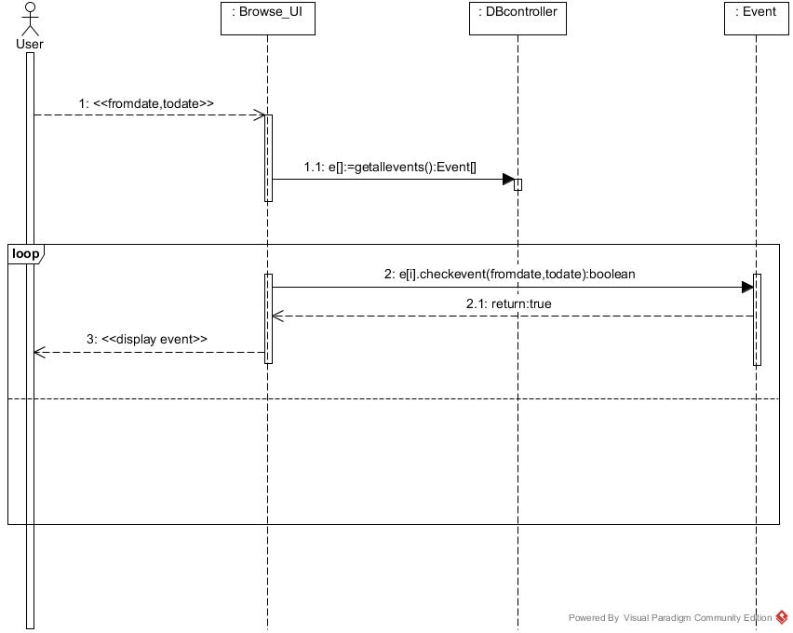
SEARCH EVENTS

Slide 27
CLASS DIAGRAM

Slide 28
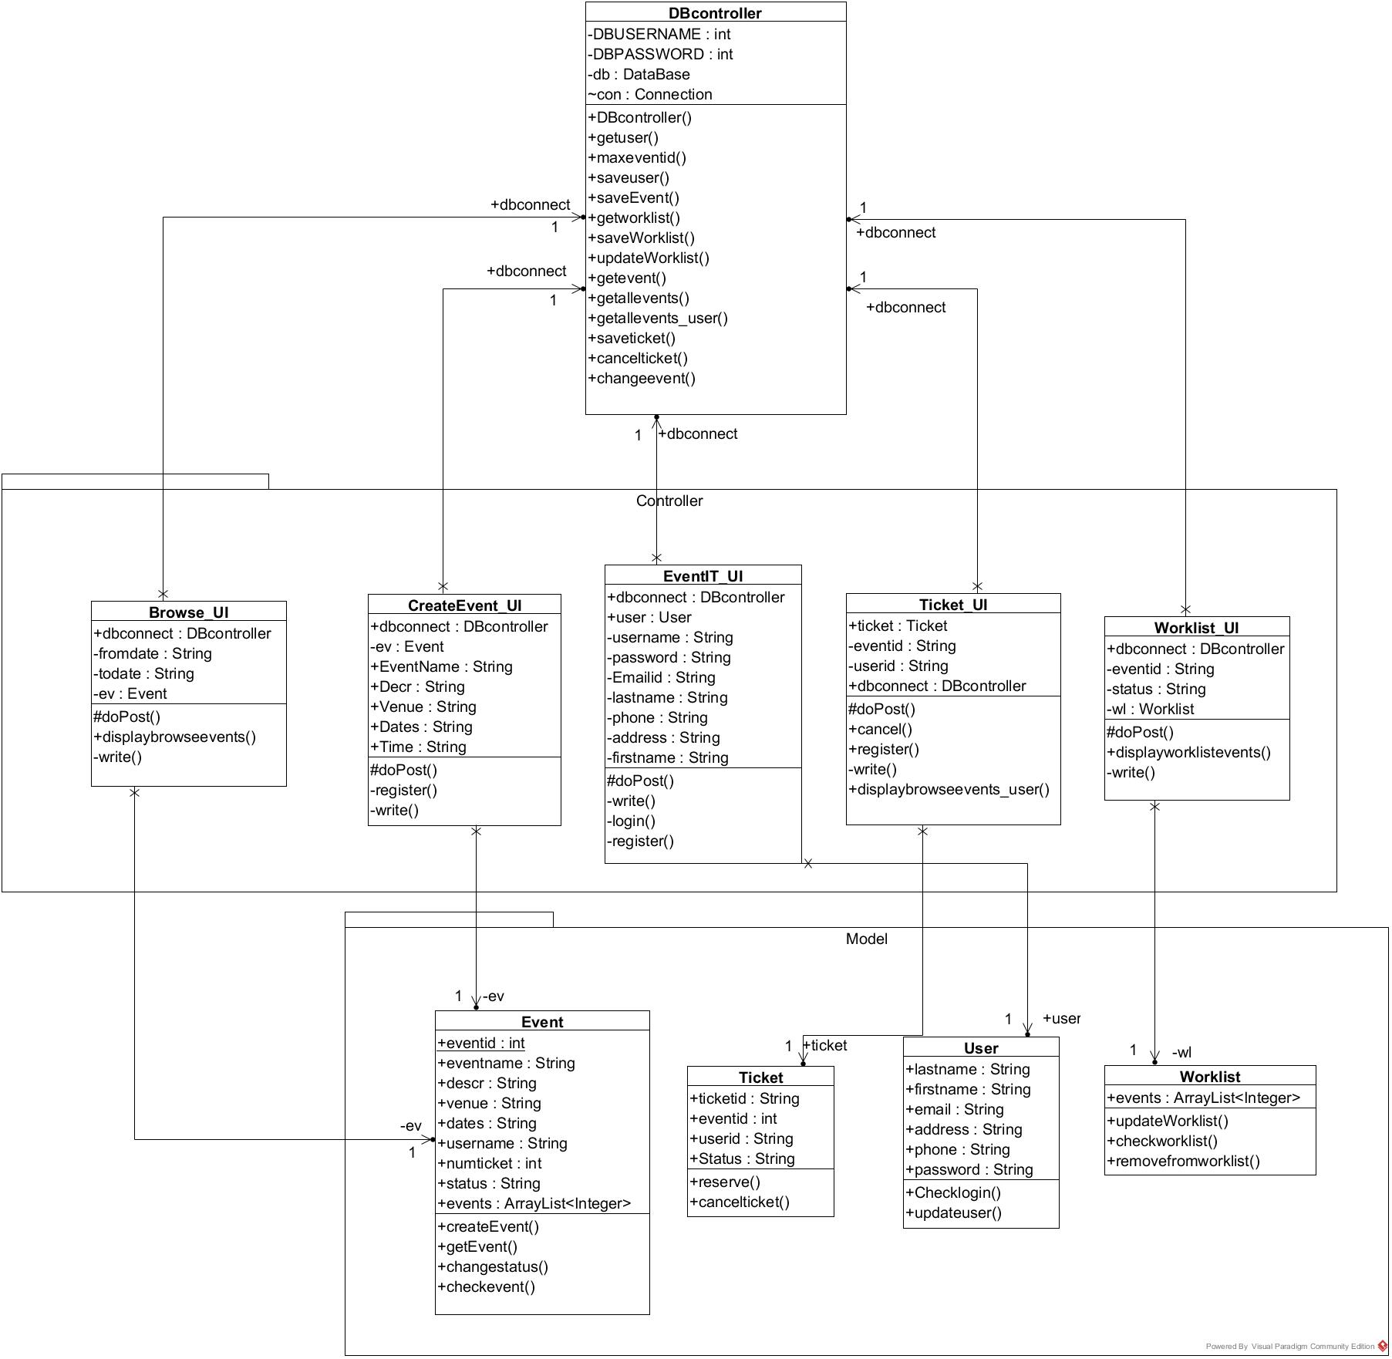

Slide 29
PLAN FOR ITERATION 3
Requirement analysis
Update event module
Delete event module
Rate and comment module
Refine the system
Documentation and Report
Backlogs from iteration 2

Slide 30
FEEDBACK !

